Slide 1
Collective Worship
https://www.youtube.com/watch?v=XbxNtPiCBK8 Play song as pupils are entering.

Slide 2

Temptation to gossip
Opening prayers
Begin Collective worship with worship council members saying prayers and lighting candles.
Joy

Slide 3
Learning from Jesus Christ, the Prince of Peace, to work diligently, act generously and live at peace with everyone.
Psalm 34:14 - Seek peace and pursue it.
Today’s theme is all about the temptation to gossip. Have you ever been tempted to gossip about someone else?
How does our vision here at William Ford suggest ways in which we can prevent gossiping?
Jahmene

Slide 4
Theme: Temptation to gossip
Bible verse: Proverbs 26:20-22.
Joanna and Ladyta
20 Without wood, a fire goes out; without gossip, quarreling stops. 21 Charcoal keeps the embers glowing, wood keeps the fire burning, and troublemakers keep arguments alive.22 Gossip is so tasty! How we love to swallow it!
Show video
https://www.youtube.com/watch?v=CSrf0NGsrzo

Slide 5

-Perhaps someone has worn a funny outfit.
-Perhaps you just don’t like someone and you want others to dislike this person too.
Have you ever had the temptation to gossip?
Michael F
Samuel
Share examples of temptations to gossip.

Slide 6
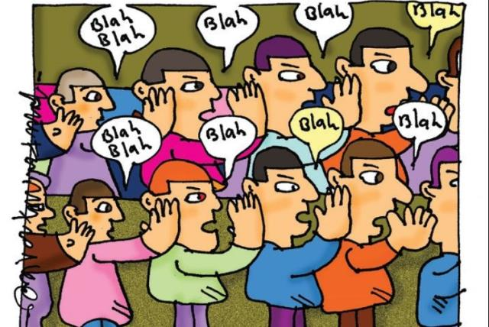
Gossip sketch
Jose
Bridget
Jahmene
Joy
Deborah
Anita
Ladyta
Worship council pupils to act out a scene of gossip, with a freeze frame. Pupils to ask audience what they should do if they were in the shoes of the person who is tempted to gossip.

Slide 7
There is something about gossiping that really makes us want to spill it out. Some people do it to make them feel superior to others. Some do it to deliberately hurt other people. Some do it out of envy, for attention, anger, revenge, or simply just out of boredom.
No matter what your reason may be, God holds you accountable for what you say during this lifetime (Matthew 12:36). He listens to every word you say. Sooner or later, you will reap the negative effects of gossiping, during this lifetime and for the life to come.
Jose

Slide 8
3 Tips for resisting the temptation to gossip:
1. If you can’t say anything good, don’t say anything at all
The best way to stop gossiping is to simply say NO. Say no to the urge to share rumours or hurtful information. Most of the time, when you hear gossip, there is really no way you can be 100% sure if the information is true or not. In addition to this, you can only see the outward appearance of a situation, but not the heart, which only God can perfectly do.
2. Imagine yourself in the shoes of the person being gossiped
Before those words leave your mouth, think about what you are about to say. Are your words helpful? Or do your words just make the situation worse than it already is? Are you becoming a blessing to others or a burden by telling this information? Honestly answer these questions and be wise with how you act.
3. Talk through the information with the person involved
You probably heard about “talking behind people’s back”. Now that’s gossip. If you really want to discuss something, make sure that you do so with the person concerned present. This way, that person will have a chance to defend themselves or simply know about the information and do something about it.
Michael Y6

Slide 9
Reflection:
Please take a moment of silence to reflect on today’s message.
Have you ever been tempted to gossip?
How do you think the person who is being talked about might feel?
What strategies can you use to prevent yourself from gossiping?
Is there ever a time when sharing information about someone else is ok?
Bridget and Mercy
Give children a time of reflection on the above questions.
Song to end session
https://www.youtube.com/watch?v=4ZRwn_Thg2Q

Slide 10
Prayer:
Thank you for the message today. God please help us to resist the temptation to gossip. Please help us, in those situations, to remember the truths we have in our lives and to hold onto the peace that you have given us. Help us to live a life of love, joy and peace. In your mighty name, Amen.
This prayer can be said by worship council members.
Joanna

