Slide 1

Year 6 SATs
Parents’ Meeting
Wednesday 4th March

Slide 2
WHAT ARE SATS AND WHY DO CHILDREN TAKE THEM?
S – Statutory
A - Assessment
T - Tests
End of Key Stage measure of attainment and
pupil progress.

Slide 3
What are children tested on?
English – reading, spelling, grammar and punctuation
Mathematics 2 x reasoning papers and arithmetic paper

Slide 4
MATHS

Slide 5
Arithmetic Maths test – Paper 1
40 marks on calculations-lasting 30 mins-which cover the four rules, adding/subtracting/multiplying/dividing fractions, calculating percentages, working with decimals numbers.
How to help at home: Any work on times tables or practise calculations in the four operations. Internet games on calculation speed and number knowledge.

Slide 6
What is being tested?
Children are tested on the following:
Addition
Subtraction
Multiplication (including long multiplication)
Division (including long division)
Decimal numbers (various forms)
Percentages
Fractions (fractions in various forms) e.g. multiplying, adding and conversion of fractions.
Order of operations
Missing numbers in calculations
Squaring and cubing numbers

Slide 7
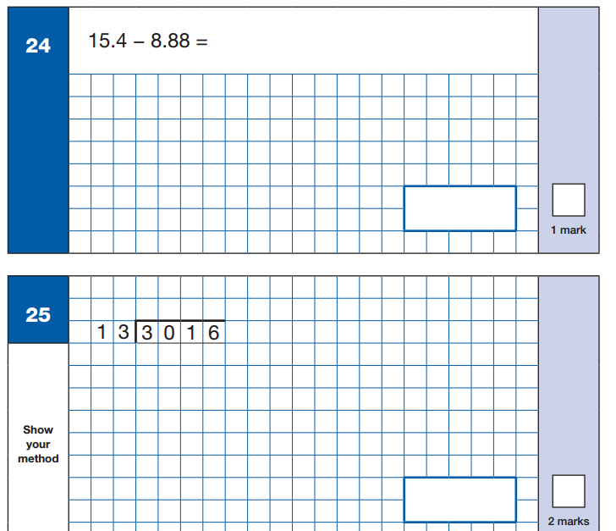
Sample Questions
Maths Paper 1: Arithmetic

Slide 8
Reasoning Maths Papers
Paper 2 and Paper 3 – Each of 40 minutes.
Children are tested on how they reason questions through and use their maths knowledge to access a mathematical problem.
Questions are usually worded or use illustrations e.g. triangles, timetables and charts.
Each question has more than one step and the children must figure out these steps.

Slide 9
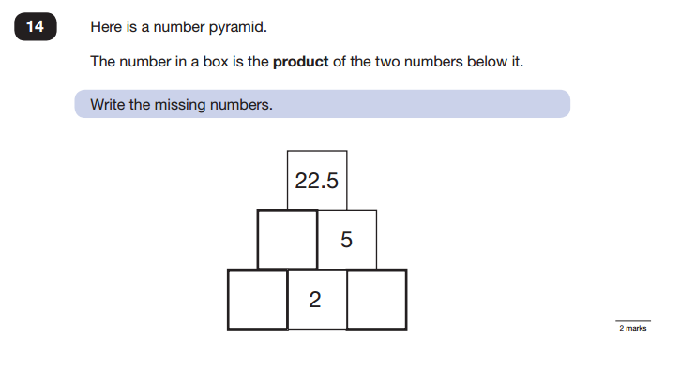
Sample Questions
Maths Paper 2 / Paper 3 : Reasoning

Slide 10
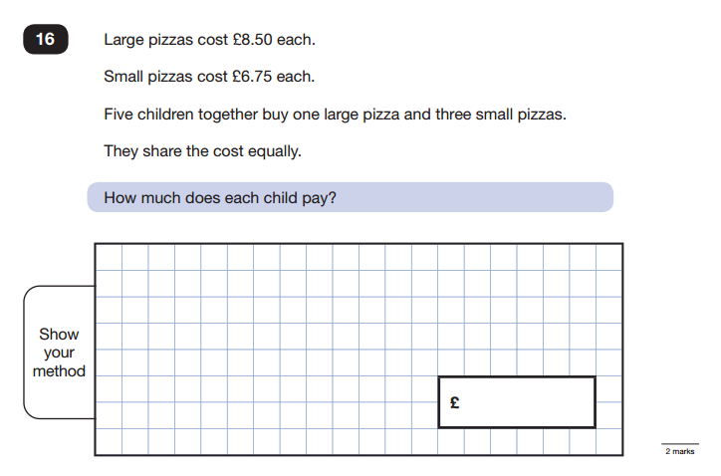
Sample Questions
Maths Paper 2 / Paper 3 : Reasoning

Slide 11
English

Slide 12
Reading
The Reading Test consists of a single test paper with three unrelated reading texts.
Children are given 60 minutes in total, which includes reading the texts and answering the questions.
A total of 50 marks are available.
Some questions are multiple choice or selected response, others require short answers and some require an extended response or explanation.
Helping at home – Children to read their reading book from the school library which is targeted at the correct level. Encourage children to talk about the book and discuss characters, actions etc. Keep up reading logs.

Slide 13
Different types of questions
Questions are designed to assess the comprehension and understanding of a child’s reading.
Range of retrieval questions – the answer is in the text and the children need to find it
Their understanding of vocabulary used in the text – the children need to use the context of the text to work out word meaning
Inference questions – the children need to use clues in the text to support their ideas and opinions
Summarising by ordering different events from text

Slide 14
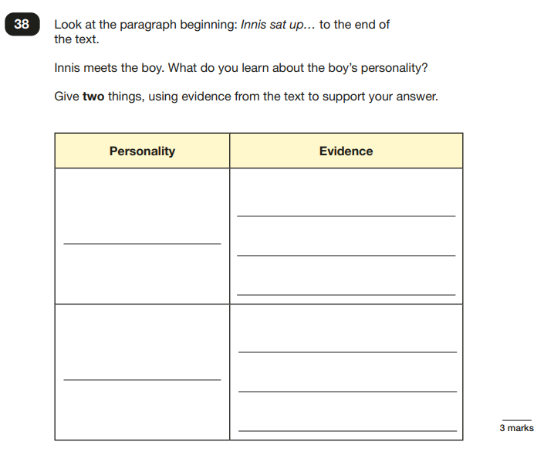
Sample Questions
Reading paper

Slide 15
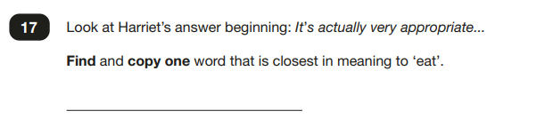
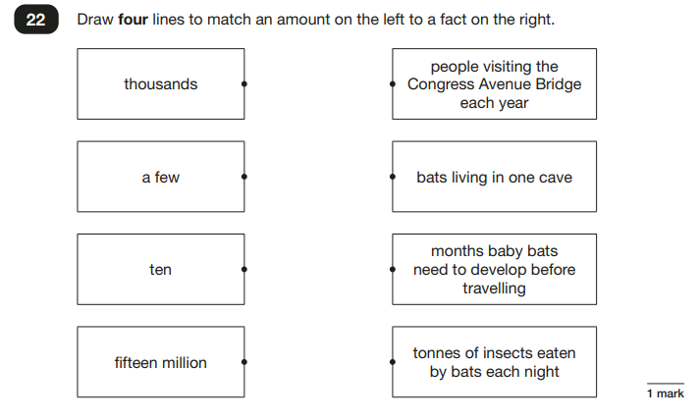
Sample Questions
Reading paper

Slide 16
Spelling, Punctuation and Grammar
A Spelling test is administered containing 20 words, lasting approximately 15 minutes.
A separate test is given on Punctuation, Vocabulary and Grammar
This test lasts for 45 minutes and requires short answer questions, including some multiple choice.
Marks for these two tests are added together to give a total for Spelling, Punctuation and Grammar.
A Spelling test is administered containing 20 words, lasting approximately 15 minutes.
A separate test is given on Punctuation, Vocabulary and Grammar
This test lasts for 45 minutes and requires short answer questions, including some multiple choice.
Marks for these two tests are added together to give a total for Spelling, Punctuation and Grammar.
Children have been working through these skills in class and have been exposed to the vocabulary.

Slide 17
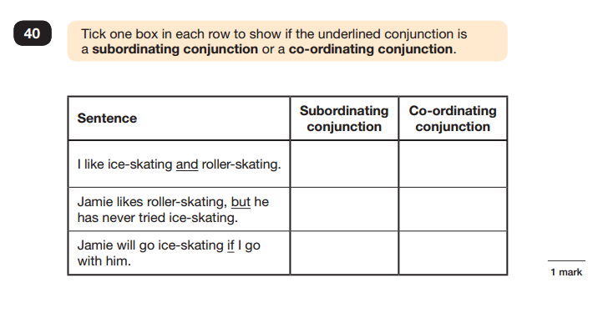
Sample Question
Grammar, Punctuation and Spelling Paper 1

Slide 18
Spelling
Children will have 20 spellings following patterns and formations taught throughout key stage 2.
The spellings are spoken to the children within the context of a sentence.
Spelling 18: The word is tongue. I burnt my tongue on the hot soup. The word is tongue.
Spelling 19: The word is accidentally. Sarah accidentally spilled water all over the table. The word is accidentally.
Spelling 20: The word is deceive. The criminal tried to deceive the police. The word is deceive.

Slide 19
General Information

Slide 20
Marks available in each test
English grammar, punctuation and spelling Paper 1: | 50 marks | 70 marks
English grammar, punctuation and spelling Paper 2: spelling | 20 marks
Mathematics Paper 1: arithmetic | 40 marks | 110 marks
Mathematics Paper 2: reasoning | 35 marks
Mathematics Paper 3: reasoning | 35 marks

Slide 21
Scaled Scores- what is meant by scaled scores?
When the children have completed their SATS they will receive a RAW score and a scaled score. The scaled score shows if the child is:
Working towards year 6 standards
At year 6 standards
At greater depth
A scaled score of less than 100 represents that the child is still working towards end of year 6 expectations
A scaled score of between 100 and 109 represents that the child is working at expected level
A scaled score of between 110 and 120 represents that they are at greater depth and have achieved an advanced understanding.
The scaled score boundaries for tests change each year depending on the difficulty of the tests.
All scaled scores can be found on the governments education website.
The children will know what to aim for through feedback from half termly assessments and SATs practice papers during our revision preparation sessions.

Slide 22
When will the tests take place?
Monday 11 May 2026 | Spelling, Punctuation & Grammar (Paper 1) Spelling, Punctuation & Grammar (Paper 2)
Tuesday 12 May 2026 | English Reading
Wednesday 13 May 2026 | Maths Paper 1 (Arithmetic) Maths Paper 2 (Reasoning)
Thursday 14 May 2026 | Maths Paper 3 (Reasoning)

Slide 23
Arrangements for test day
The tests will take place in the children’s classrooms and quiet rooms around the school. The children will have completed a number of practice tests and will be familiar with the set up and the place in which they sit.
Children are encouraged to visit the toilet and ensure they are well hydrated and comfortable before the test.
Children are allowed to bring a water bottle to the test.
Children are allowed to ask for questions to be read aloud to them (with the exception of the reading test which is completely independent).
Staff may only read the question – children are not allowed any help with spelling or to ask for clarification.
Children have the start and end time for each test displayed and are given reminders at timed intervals which they are used to as part of our test preparation sessions.

Slide 24
When will parents be informed of pupils’ results and who else will use these results?
Tests come into school on various days throughout July.
Children’s test results are transferred electronically to the appropriate secondary school.
Children will be told their results in their reports in July. All results are handled sensitively and privately.

Slide 25
How can I help my child on the lead up to and on test day?
Attendance - ensure your child is in school as much as possible.
Regular and appropriate bedtimes. Please make sure that they do not have a late night as this will make them tired and they will not be able to concentrate.
Let school know as early as possible if your child is ill during test week and if any special arrangements need to be made.
Communicate if there has been any upheaval or upset at home that may affect the pupil’s access/performance in the test.
Ensure your child has breakfast/ attends boosters/ reads with you 4 times a week/ does times table practice on TTRS / BBC Bitesize games etc.

Slide 26
Websites that are useful for revision
Arithmetic https://mathsbot.com/primary/ks2Mini
Maths BBC Bitesize https://www.bbc.co.uk/bitesize/articles/zn2y7nb
Grammar BBC Bitesize https://www.bbc.co.uk/bitesize/articles/zbm8scw
Reading using vipers questions
https://www.literacyshedblog.com/uploads/1/2/5/7/12572836/ks2_reading_vipers.pdf
Practice past papers e.g. type in ‘2022 maths SATs’ and for the answers type in ‘2022 maths SATs mark scheme’

